Slide 1
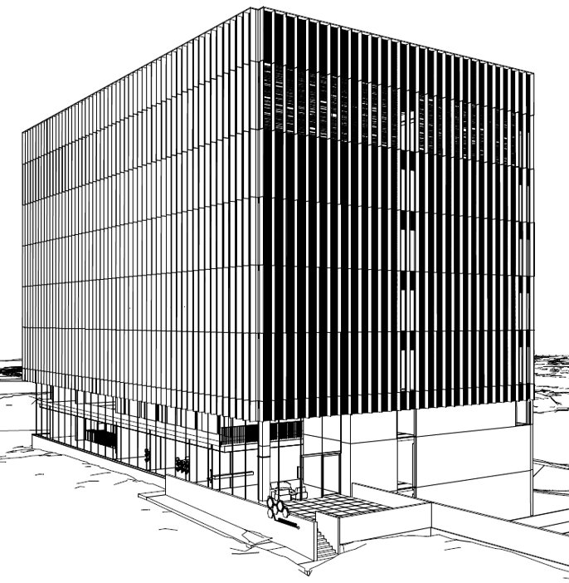
Datacenter Building Highlights
7 MW Design IT-load
Uptime Institute Tier III design & operation
BREEAM Excellent design & post construction
ISO 9001, ISO 27001
In the heart of new Innovation & Research Campus
3.500 m² total whitespace in 15 modules
2 High-density modules for VUB, UZ Brussel
1 High-density module for Tier-1 HPC
13 Medium-density colocation modules
  3 modules per building level
  400 kW/module

Slide 2
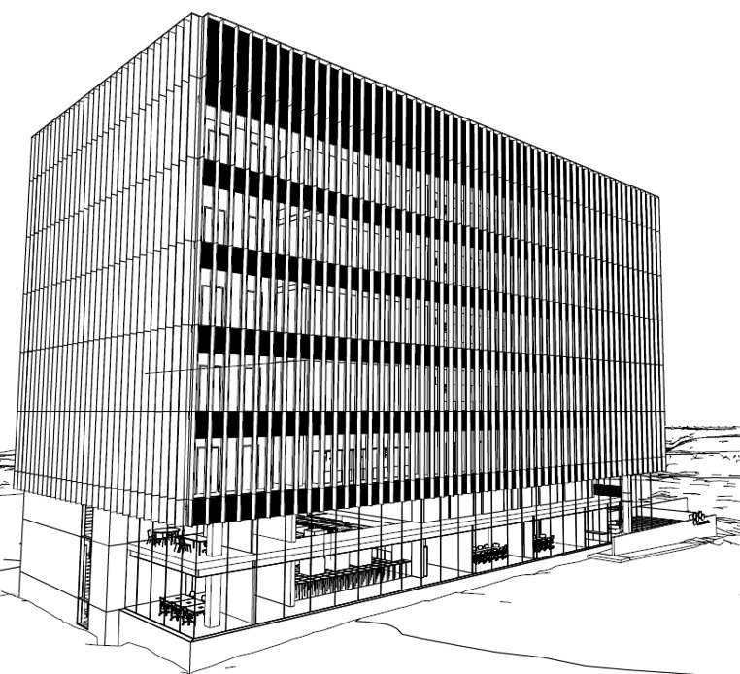
Sustainability​
First truly sustainable by design datacenter in Belgium​
100% Green Energy, in part locally generated ​
Heat Recuperation​
CO2 Neutral Smart Multi-Energy Grid on campus​
Maximum Energy Efficiency (PUE expected <1.2)​
Circular Architecture​

Slide 3
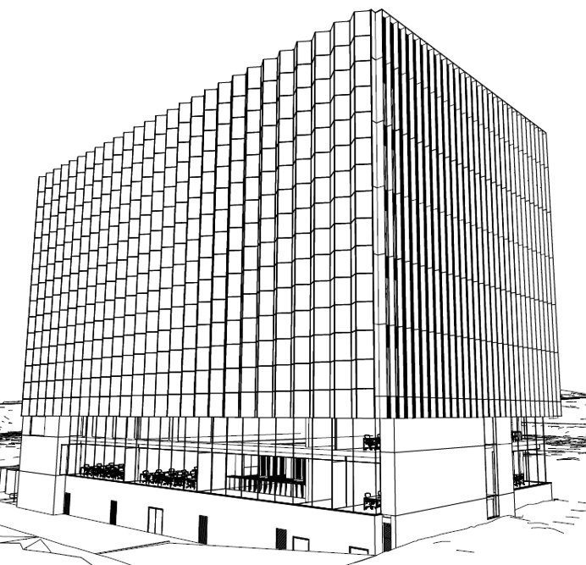
Energy Efficient Electrical Design​
Highly Modular design: transformers, UPS, CRAH,…​
Gensets: N+1, 5 x 2.500 kVA, grid feeding​
​
Solar: On-site up to 0,5 MW peak​
Energy Efficient HVAC​
Heat Recuperation for On-Campus Energy Grid​
Maximizing Free Cooling:
  Dry-Coolers with Adiabatic Assist​
  Cooling Towers w/ rainwater basins in basement​
  Traditional chillers as back-up​

